Slide 1
Inter-Computer Communications (Networking One)
Week 5 3 IP Addressing

Slide 2
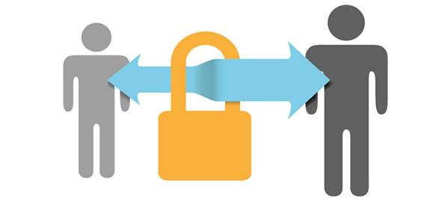
Protocols
For communication to occur, the entities must agree on a protocol.
A protocol is synonymous with rule. It consists of a set of rules that govern data communications.
It determines what is communicated, how it is communicated and when it is communicated.
The key elements of a protocol are syntax, semantics, and timing.

Slide 3
Standards
Standards provide guidelines to manufacturers, vendors, government agencies, and other service providers to ensure the kind of interconnectivity necessary in today's marketplace and in international communications.
International Organization for Standardization (ISO)
International Telecommunication Union-Telecommunication Standards Sector (ITU-T)
American National Standards Institute (ANSI)
Institute of Electrical and Electronics Engineers (IEEE)
Electronic Industries Association (EIA)

Slide 4
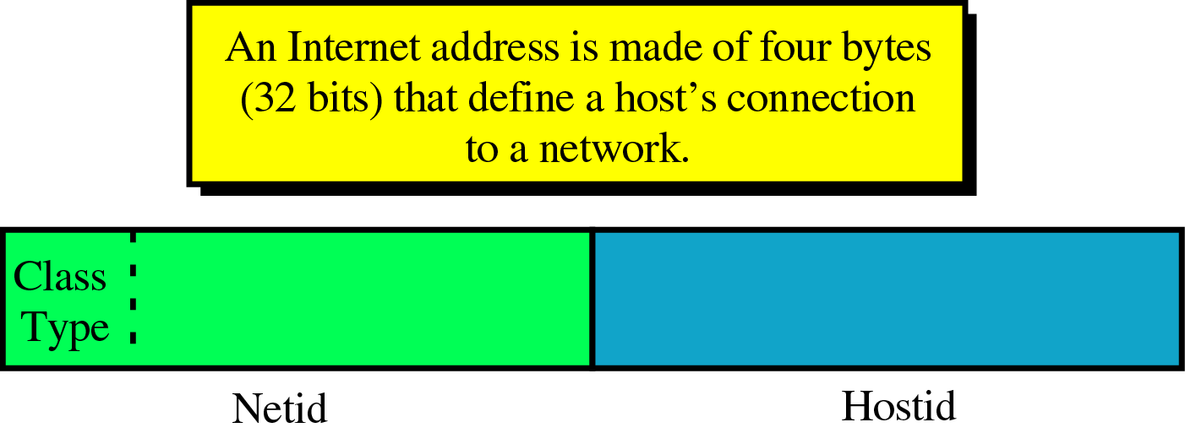
IPv4 Addressing
An IPv4 address is a 32-bit binary address, implemented in software, that Uniquely and Universally defines a host or a router on the Internet.
IP addresses are Unique in the sense that no two devices can have the same address, however a device can have more than one address.
Each Internet address contains four bytes (32 bits) defining two fields: netid and hostid.
Notes:
IPv4 uses 32-bit addresses, which means that the address space is 2³² or 4,294,967,296 (more than 4 billion). This means that, theoretically, if there were no restrictions, more than 4 billion devices could be connected to the Internet.

Slide 5
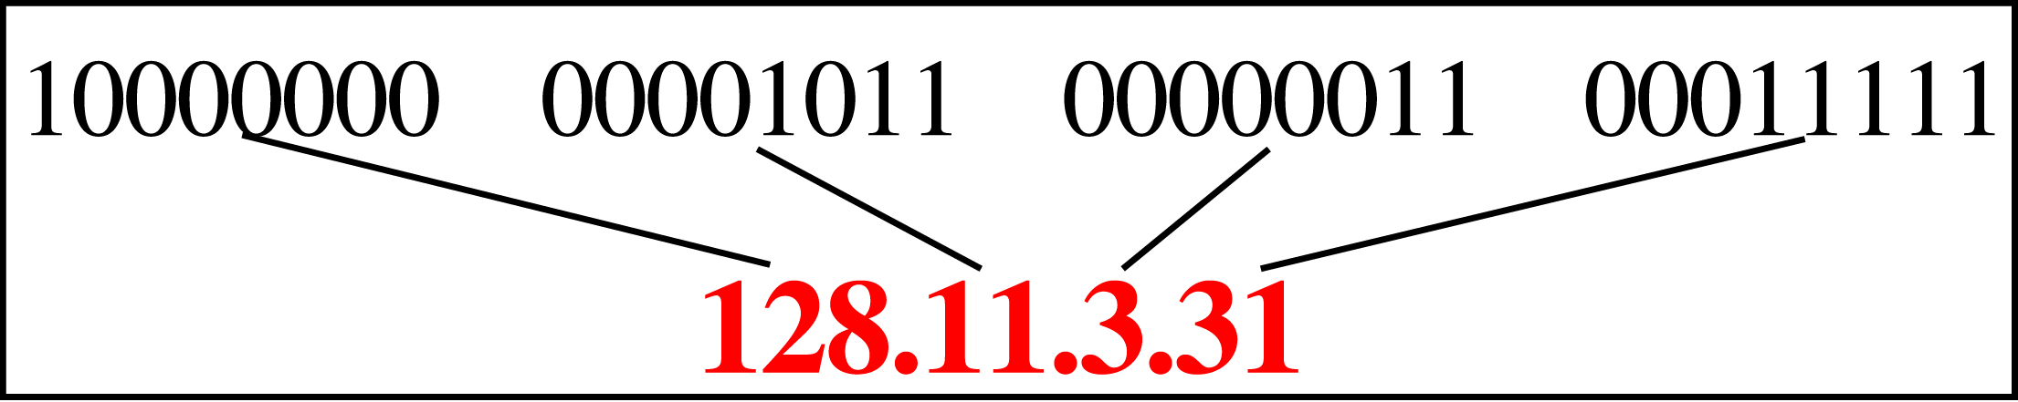
IPv4 Addressing
The netid defines the network and the hostid identifies the host on the network.
These parts are of varying length depending on the class of the address.
IP addresses are most often expressed in dotted-decimal notation:

Slide 6
IPv4 Addressing
Example 1
Change the following IP addresses from binary notation to dotted-decimal notation.
a. 10000001 00001011 00001011 11101111
b. 11111001 10011011 11111011 00001111
Solution
We replace each group of 8 bits with its equivalent decimal number and add dots for separation:
a. 129.11.11.239
b. 249.155.251.15

Slide 7
IPv4 Addressing
Example 2
Change the following IP addresses from dotted-decimal notation to binary notation.
a. 111.56.45.78
b. 75.45.34.78
Solution
We replace each decimal number with its binary equivalent :
a. 01101111 00111000 00101101 01001110
b. 01001011 00101101 00100010 01001110

Slide 8
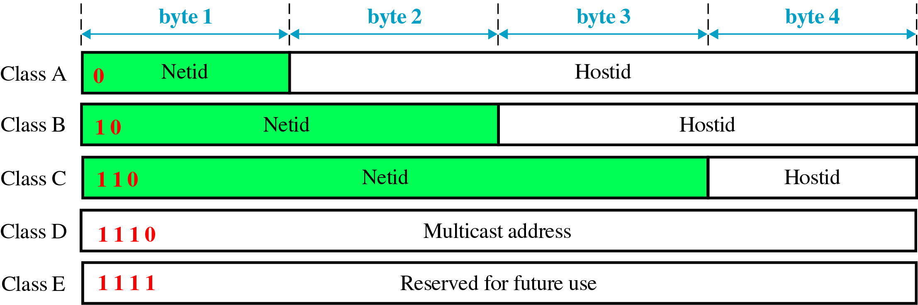
IPv4 Address Classes
There are five different IP address classes: A, B, C, D, and E.

Slide 9
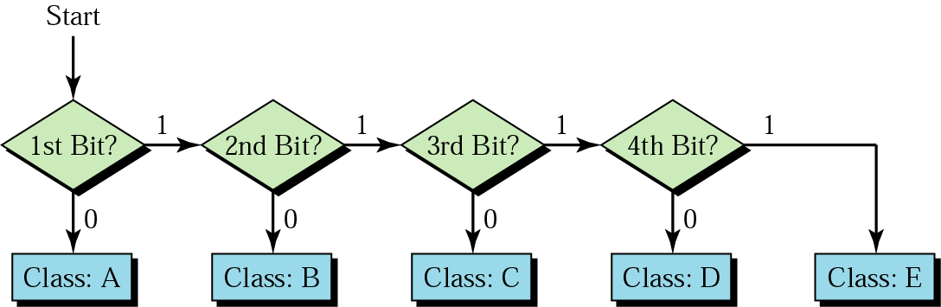
IPv4 Address Classes
Finding the class:

Slide 10
IPv4 Address Classes
Example 3
Find the class of each address:
a. 00000001 00001011 00001011 11101111
b. 11110011 10011011 11111011 00001111
Solution
a. The first bit is 0; this is a class A address.
b. The first 4 bits are 1s; this is a class E address.

Slide 11
IPv4 Address Classes
Class A addresses are designed for the governments and organisations that may have a huge number of computers attached to their networks.
Class B addresses are designed for medium-to-large sized companies.
Both Class A and Class B addresses are often wasteful as many addresses are not used up.
Class A and Class B addresses have been virtually depleted.
Class C addresses are designed for small organisations that have a small number of computers attached to their networks.
Those requesting Internet addresses are now usually issued only Class C addresses.

Slide 12
IPv4 Address Classes
Class D address is defined for multicasting. In this class, there is no netid or hostid. The first four bits define the class (1110). The remaining 28 bits define different multicast addresses.
Class E is reserved by the Internet for special use. There is no netid or hostid in this class.
The first four bits define the class (1111).
Notes:
A multicast address, also called a group address, is a single IP address for a set of hosts that are joined in a multicasting group.
Unicast Message:
One device will send the message to exactly one destination device. If some device needs to send a message to multiple devices, it will have to send multiple unicast messages, each message addressed to a specific device. So, the sender has to send a separate message to each destination device, and to do that it has to know the exact IP address of each destination device.
Broadcast Message:
The second method of sending messages is called the broadcasting. Broadcast is a packet that’s sent to all devices on specific network. The destination address in the packet is the special broadcast address. If the packet has a broadcast address, all devices that receive that message will process it. So, all devices on the same network segment will see the same message.
Multicast Message:
Multicasting identifies logical groups of computers. A single message can then be sent to the group. Multicasting uses the Internet Group Management Protocol (IGMP) to identify groups and group members. Routers will also use IGMP to send messages to subnets that have group members.

Slide 13
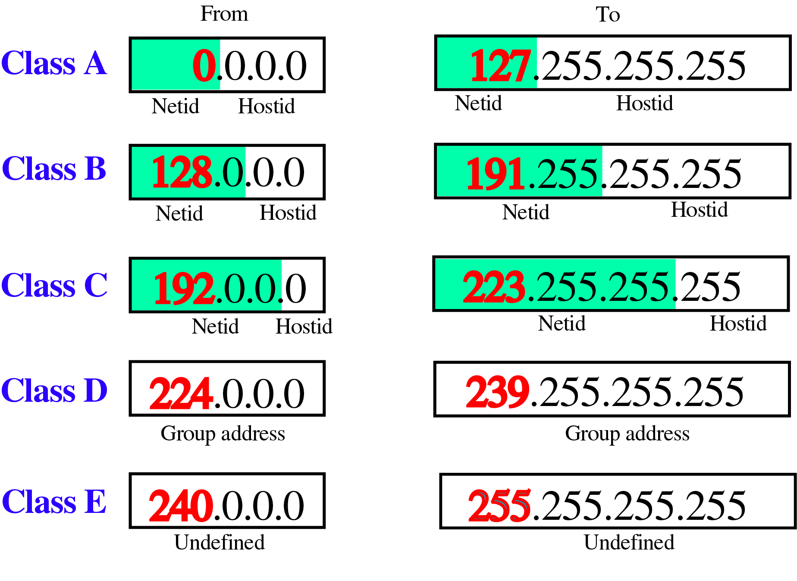
Dotted-Decimal Notation

Slide 14
Internet Address Exercises
Example 4
Find the class of each address:
a. 227.12.14.87
b. 252.5.15.111
c. 134.11.78.56
Solution
a. The first byte is 227 (between 224 and 239); the class is D.
b. The first byte is 252 (between 240 and 255); the class is E.
c. The first byte is 134 (between 128 and 191); the class is B.

